Slide 1
Machine Learning CS F464
Dr. Pranav M. Pawar

Slide 2
Contents
Reinforcement Learning
Markov Decision Process
Q-Learning Algorithm

Slide 3
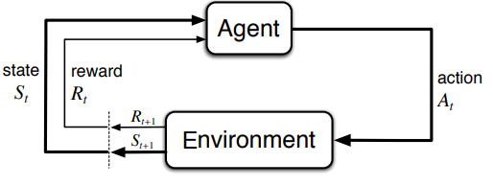
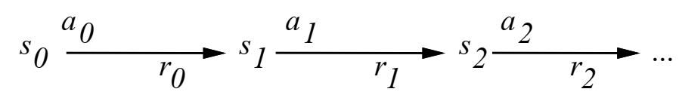
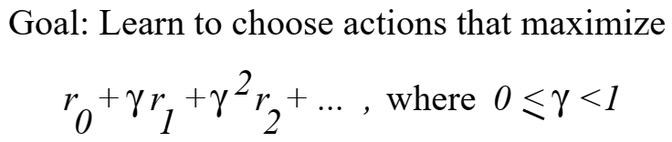
Reinforcement Learning
Describes a class of problems where an agent operates in an environment and must learn to operate using feedback.
In RL problems there is a learner and a decision maker called agent and the surrounding with which it interacts is called environment. The environment, in return, provides rewards and a new state based on the actions of the agent.

Slide 4
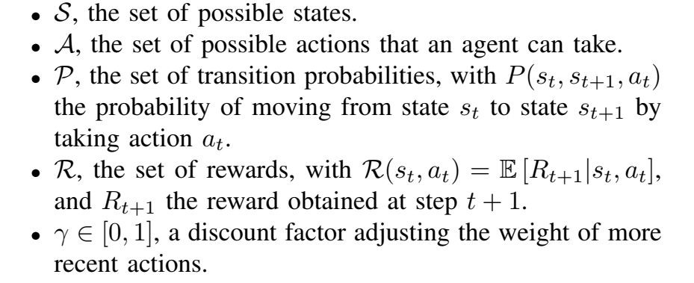
Markov Decision Process (MDP)
RL problems are described using MDP.
A MDP is defined as,

Slide 5
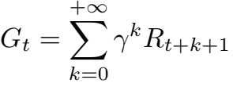

Markov Decision Process (MDP)
The cumulative reward (discounted) or long term reward is defined as,
A policy is a simple function, that defines a probability distribution over Actions (a∈ A) for each state (s ∈ S). If an agent at time t follows a policy π then π(a|s) is the probability that agent with taking action (a) at particular time step (t).

Slide 6

Markov Decision Process (MDP)
The value of state s, when agent is following a policy π which is denoted by v_{π}(s) is the expected return starting from s and following a policy π for the next states, until we reach the terminal state.
The above function is called as state-value function.

Slide 7
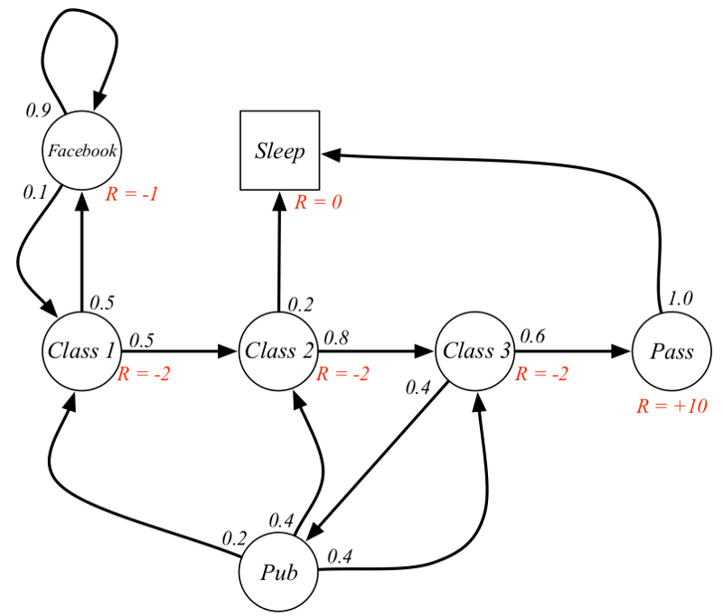
Example
Suppose our start state is Class 2, and we move from Class 2 -> Class 3 -> Pass -> Sleep.
Consider γ = 0.5.
Expected rewards w.r.t to current state and given policy are,
G_{t} = -2 + (-2 * 0.5) + 10 * 0.25 + 0 = -0.5

Slide 8

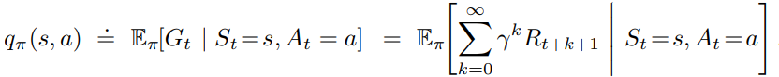
Markov Decision Process (MDP)
As an agent learning task, the task of agent is to learn a policy π which maximizes v_{π}(s) for all state s. Hence, optimal policy is defined as,
Here, we can also define state-action function,
It tells us the value of performing a certain action(a) in a state(s) with a policy π.

Slide 9
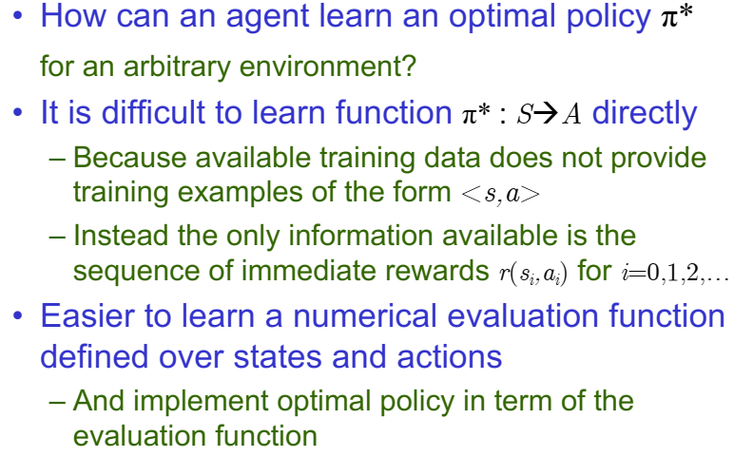
Q-learning

Slide 10
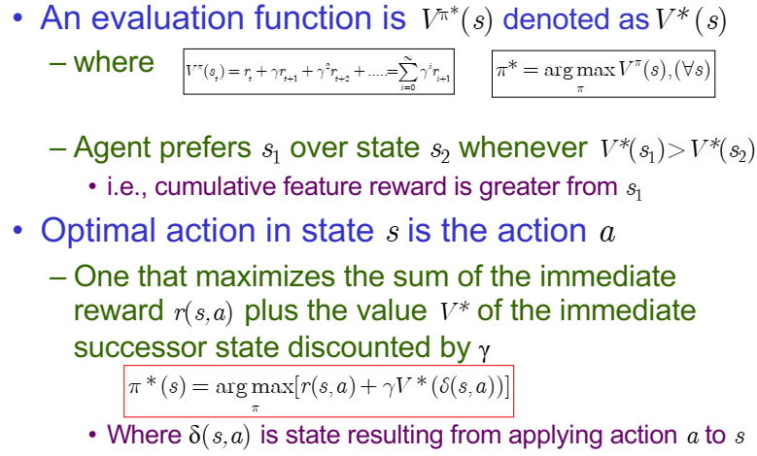
Optimal Function for State

Slide 11
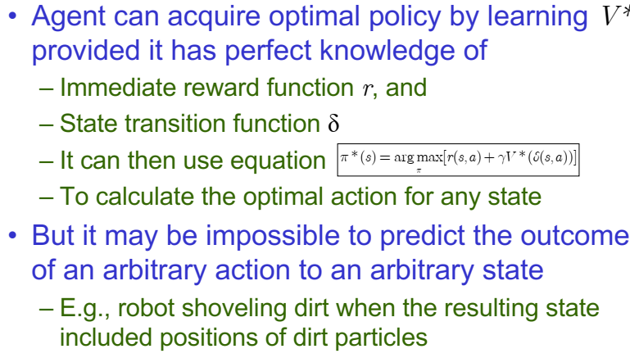
Perfect Knowledge Requirement

Slide 12
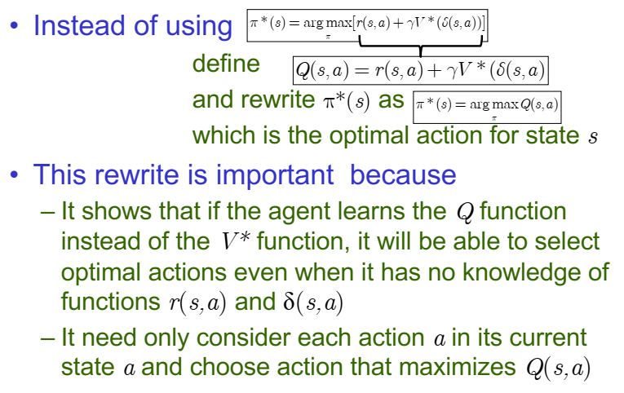
Q-function

Slide 13
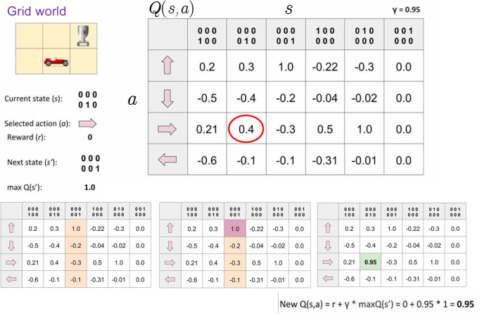
Example of Q-function and Q-learning

Slide 14
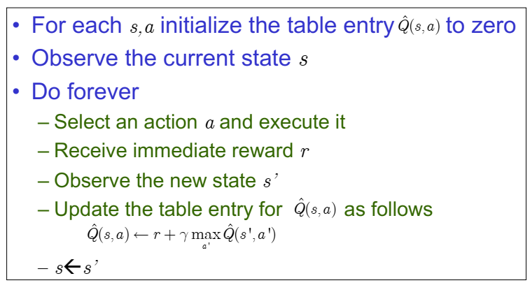
Q-learning Algorithm

Slide 15
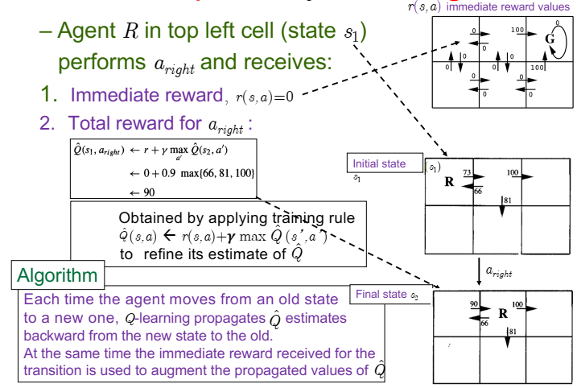
Q-Learning Example

Slide 16
Sources
Chapter 9, Christopher M. Bhisop, Pattern Recognition & Machine Learning, Springer, 2006.
Chapter 6 and 14, Marsland Stephen, Machine Learning – An Algorithmic Perspective, 2e, CRC Press,2015.
Chapter 6 and 7, Alpaydin Ethem. Introduction to Machine Learning, 3e, PHI, 2014.
http://www.facweb.iitkgp.ac.in/~sudeshna/courses/ml08
https://www.cse.unr.edu/~bebis/CS479/Lectures
Machine Learning Lectures by Prof. Andrew NG at Stanford University
Chapter 13, Tom M. Mitchell, Machine Learning, The McGraw-Hill Companies, 1st edition 2013.
https://cedar.buffalo.edu/~srihari/CSE574
https://towardsdatascience.com/introduction-to-reinforcement-learning-markov-decision-process-44c533ebf8da

Slide 17
Thank You!

